Slide 1

Introduction To Management
Course Code: GC152
Lecture # 08
By
ISLAM ZADA
Lecturer in Department of Computer Science & Software Engineering,
International Islamic University, Islamabad.

Slide 2
14 principles of management
Hierarchy of need theory.
The qualities of a good leader

Slide 3
14 principles of management given by Henry Fayol
The business operations of an organization could be divided into six activities
Division of work: According to Henry Fayol work should be divided and subdivided with various individual according to their expertise skills and knowledge in a particular area.
With division of work it helps individual in acquiring speed, accuracy in his performance. Specialization leads to efficiency and effectiveness for organization.
Authority and Responsibility: The concept of authority and responsibility are closely related.
Authority was defined by Fayol as the right to give orders and powers to match duty.
Responsibility involves being accountable, and is therefore naturally associated with authority. Whoever assumes authority also assumes responsibility.

Slide 4
14 principles of management given by Henry Fayol
Unity of command: Subordinates should receive orders and be answerable to one and only one boss at a time. In other words, subordinates should not receive instructions from more than one person.
Unity of command provides the enterprise of disciplined, stable and orderly existence. It creates harmonious relationship between superiors and sub-ordinates.
Unity of Direction: the entire organization should be moving towards a common direction.
According to this principle, efforts of all the members of the organization should be directed towards common goal.

Slide 5
14 principles of management given by Henry Fayol
Scalar Chain: Managers in hierarchies are part of a chain like authority scale. Each manager, from the first line supervisor to the president, possesses certain amounts of authority.
The President possesses the most authority; the first line supervisor the least. Lower level managers should always keep upper level managers informed of their work activities.
The existence of a scalar chain and adherence to it are necessary if the organization is to be successful.
Discipline: According to Fayol, “Discipline means sincerity, respect of authority and observance of rules and regulation of the enterprise”.
This principle applies that subordinate should respect their superiors and obey their order.

Slide 6
14 principles of management given by Henry Fayol
Initiative: Workers should be encouraged to take initiative in the work assigned to them.
Fayol advised to them. Fayol advised that management should provide opportunity to its employees to suggest ideas, experiences and new method of work.
Fair remuneration: Fayol suggested that remuneration to be paid to the workers should be fair, reasonable, satisfactory and rewarding of the efforts.
As far as possible remuneration should satisfy employer as well as employee.
Fayol also recommended provision of other benefits such as free education, medical and residential facilities to workers.
Stability: Fayol emphasized that employees should not be moved frequently, from one job to another.

Slide 7
14 principles of management given by Henry Fayol
Stability of Tenure of Personnel: Retaining productive employees should always be a high priority of management.
Recruitment and Selection Costs, as well as increased product-reject rates are usually associated with hiring new workers.
Espirit de Corps: Management should encourage harmony and general good feelings among employees.
.

Slide 8
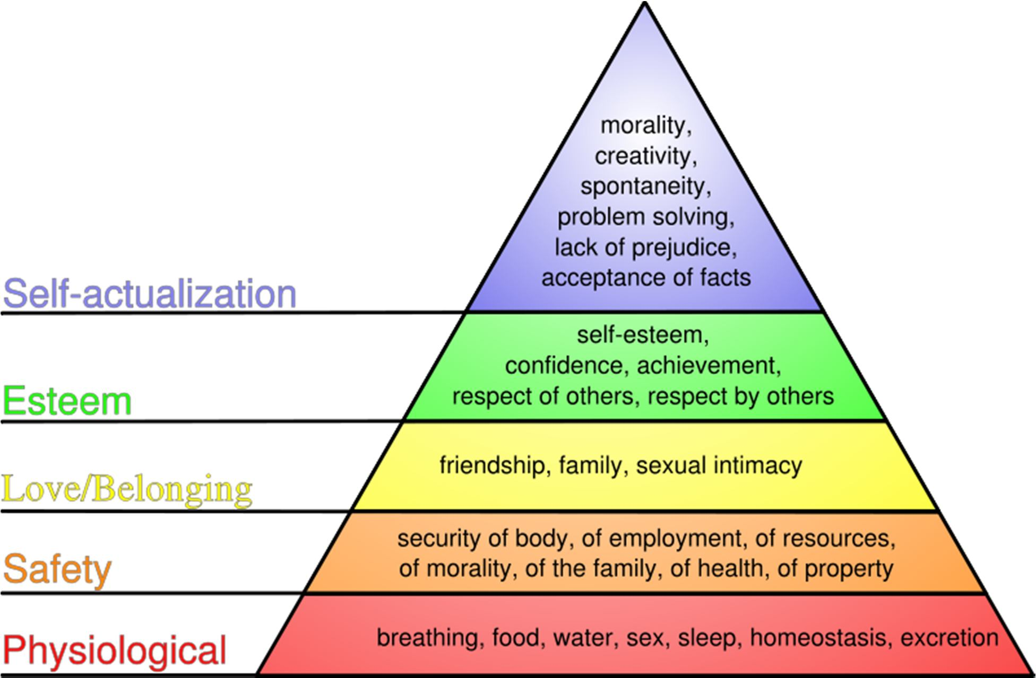
Hierarchy of need theory

Slide 9
Hierarchy of need theory
Physiological Needs:
Physiological needs are those required to sustain life, such as:
air
water
nourishment
Sleep
According to Maslow's theory, if such needs are not satisfied then one's motivation will arise from the quest to satisfy them.
Higher needs such as social needs and esteem are not felt until one has met the needs basic to one's bodily functioning.

Slide 10
Hierarchy of need theory
Safety:
• Once physiological needs are met, one's attention turns to safety and security in order to be free from the threat of physical and emotional harm.
Such needs might be fulfilled by::
Living in a safe area
Medical insurance
Job security
Financial reserve
According to Maslow's hierarchy, if a person feels that he or she is in harm's way, higher needs will not receive much attention..

Slide 11
Hierarchy of need theory
Social Needs:
Once a person has met the lower level physiological and safety needs, higher level needs become important, the first of which are social needs.
Social needs are those related to interaction with other people and may include:
Need for friends
Need for belonging
Need to give and receive love

Slide 12
Hierarchy of need theory
Esteem:
Once a person feels a sense of "belonging", the need to feel important arises.
Esteem needs may be classified as internal or external. Internal esteem needs are those related to self-esteem such as self-respect and achievement.
External esteem needs are those such as social status and recognition. Some esteem needs are:
Self-respect
Achievement
Attention
Recognition
Reputation
Maslow later refined his model to include a level between esteem needs and self- actualization: the need for knowledge and aesthetics..

Slide 13
Hierarchy of need theory
Self-Actualization:
It is the quest of reaching one's full potential as a person.
Unlike lower level needs, this need is never fully satisfied; as one grows psychologically there are always new opportunities to continue to grow.
Truth
Justice
Wisdom
Meaning
Self-actualized persons have frequent occurrences of peak experiences, which are energized moments of profound happiness and harmony.
According to Maslow, only a small percentage of the population reaches the level of self-actualization.

Slide 14
The Qualities of a Good Leader
1. Proactive vs. Reactive:
The exceptional leader is always thinking three steps ahead.
Working to his/her own environment with the goal of avoiding problems before they arise.
2. Flexible/Adaptable
How do you handle yourself in unexpected or uncomfortable situations? An effective leader will adapt to new surroundings and situations, doing his/her best to adjust.
A Good Communicator:
As a leader, one must listen...a lot! You must be willing to work to understand the needs and desires of others.
A good leader asks many questions, considers all options, and leads in the right direction.

Slide 15
The Qualities of a Good Leader
4. Respectful:
Treating others with respect will ultimately earn respect.
5. Quiet Confidence:
Be sure of yourself with humble intentions..
6. Enthusiastic:
Excitement is contagious. When a leader is motivated and excited about the cause people will be more inclined to follow.
7. Open-Minded:
Work to consider all options when making decisions.
A strong leader will evaluate the input from all interested parties and work for the betterment of the whole.

Slide 16
The Qualities of a Good Leader
8. Resourceful:
Utilize the resources available to you.
If you don't know the answer to something find out by asking questions. A leader must create access to information.
9. Rewarding:
An exceptional leader will recognize the efforts of others and reinforce those actions. We all enjoy being recognized for our actions!
10. Well Educated:
Knowledge is power. Work to be well educated on community policies, procedures, organizational norms, etc.
Further, your knowledge of issues and information will only increase your success in leading others.
11. Open to Change:
A leader will take into account all points of view and will be willing to change a policy, program, cultural tradition that is outdated, or no longer beneficial to the group as a whole..

Slide 17
The Qualities of a Good Leader
12. Interested in Feedback:
How do people feel about your leadership skill set? How can you improve? These are important questions that a leader needs to constantly ask the chapter.
View feedback as a gift to improve.
13. Evaluative:
Evaluation of events and programs is essential for an organization/group to improve and progress.
An exceptional leader will constantly evaluate and change programs and policies that are not working.
14. Organized:
Are you prepared for meetings, presentations, and events and confident that people around you are prepared and organized as well?.

Slide 18
The Qualities of a Good Leader
15. Consistent:
Confidence and respect cannot be attained without your leadership being consistent. People must have confidence that their opinions and thoughts will be heard and taken into consideration.
16. Delegator:
An exceptional leader realizes that he/she cannot accomplish everything on his own.
A leader will know the talents and interests of people around him/her, thus delegating tasks accordingly.
17. Initiative:
A leader should work to be the motivator, an initiator.
He/she must be a key element in the planning and implementing of new ideas, programs, policies, events, etc..

Slide 19
Introduction to Management, 13th Edition International Student Version, John R. Schermerhorn Jr., Daniel G. Bachrach, ISBN: 978-1-118-95118-7
Introduction to Management-4th Edition. Author(s):Richard Pettinger, publisher: Red Globe Press.

